Slide 1
FACE MASK RECOGNITION
IN REAL TIME VIDEO STREAM
Group No : 12
Rno 18 : Maskinder Singh
Rno 48 : Shruti Aswal
Rno 56 : S Shankarakrishnan
GUIDED BY : SUMESH RAMAN
CSEB 2019-2023

Slide 2
TABLE OF CONTENTS
01
04
02
05
03
06
Problem Statement
Software/ Hardware Requirements
Problem is stated.
Both software and hardware are stated.
Literature Survey
External Interface Requirements
Face Mask Detection using OpenCV, Keras and Deep Learning.
Other necessary requirements
Product Function
Architectural Design
Detect whether a person is wearing a mask or not.
Stage 1 : Train Face Mask Detector
Stage 2 : Apply Face Mask Detector

Slide 3
PROBLEM DEFINITION
Corona virus sickness has become a big public health issue in 2019. Because of its contact-transparent characteristics, it is rapidly spreading. The use of a face mask is among the most efficient methods for preventing the transmission of the Covid-19 virus.
Wearing the face mask alone can cut the chance of catching the virus by over 70%. Consequently, World Health Organization (WHO) advised wearing masks in crowded places as precautionary measures. Because of the incorrect use of facial masks, illnesses have spread rapidly in some locations.
To solve this challenge, we needed a reliable mask monitoring system. Numerous government entities are attempting to make wearing a face mask mandatory; this process can be facilitated by using face mask detection software.

Slide 4

FACE MASK RECOGNITION IN REAL TIME VIDEO STREAM
The topic is Face Mask Detection using OpenCV, Keras and Deep Learning.
Our model is aimed at detecting a mask and will prove very useful in a situation like Covid-19.
This topic was chosen by us due to the ongoing pandemic to help society and solve a real-life problem.

Slide 5
LITERATURE SURVEY
MAMATA S. KALAS, REAL TIME FACE DETECTION AND TRACKING USING OPENCV,
International Journal of Soft Computing and Artificial Intelligence, ISSN: 2321-404X, Volume-2, Issue-1, May- 2014
The research paper “Facial Recognition System for People with and without Face Mask in Times of the COVID-19 Pandemic, 2021” & The author of this research paper is Jonathan S. Talahua, Jorge Buele, & The outcome is the Review and comparison of face detection algorithms.
B. A, N. K. M, A. Kumar Sivaraman, R. Vincent and R. M, ”Mask Detection in Crowded Environment using Machine Learning,” 2021 2nd International
Conference on Smart Electronics and Communication (ICOSEC), 2021, pp. 1202-1206
V. S.V, M. Katti, A. Khatawkar and P. Kulkarni, ”Face Detection and Tracking using OpenCV”, The SIJ Transactions on Computer Networks Communication Engineering, vol. 04, no. 03, pp. 01-06, 2016. Available:10.9756/sijcnce/v4i3/0103540102

Slide 6
SOFTWARE/ HARDWARE REQUIREMENTS
HARDWARE REQUIREMENTS :
OPERATING SYSTEM : WINDOWS
HARD DISK : 50GB
RAM :512 MB
CPU :FOR WEB 1.6GHZ
SOFTWARE REQUIREMENTS :
TOOLS :
OPEN CV
KERAS
TENSOR FLOW
GOOGLE COLLAB

Slide 7
VALUE ADDITION
Product Functions
The main requirement for imposing this challenge, is the usage of python programming language together with Machine learning and with additional python libraries. We will use MobileNetV2, a highly efficient architecture that can be applied to embedded devices with limited computational capacity.
Scans faces in real time with no much delay.
Converts a single image to an array of images.
Detects whether people are wearing a mask or not.
Gives output -
With mask in green with the accuracy.
Without mask in red with the accuracy.

Slide 8
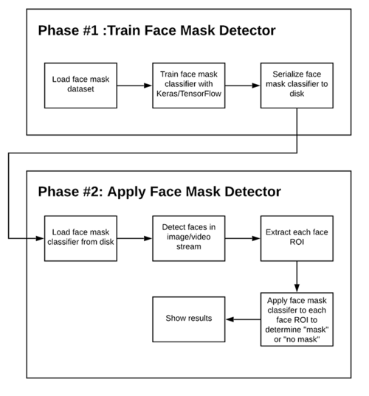
ARCHITECTURAL DESIGN
The project will be completed in two phases which are as follows:-
1. Training: Here we’ll focus on loading our face mask detection dataset from disk, training a model (using Keras/TensorFlow) on this dataset, and then serializing the face mask detector to disk.
2. Deployment: Once the face mask detector is trained, we can then move on to loading the mask detector, performing face detection, and then classifying each face as
with_mask
or
without_mask.

Slide 9
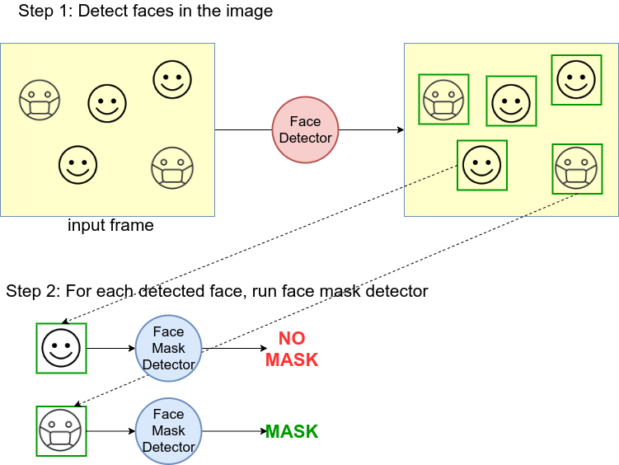
USE CASE DIAGRAM

Slide 10
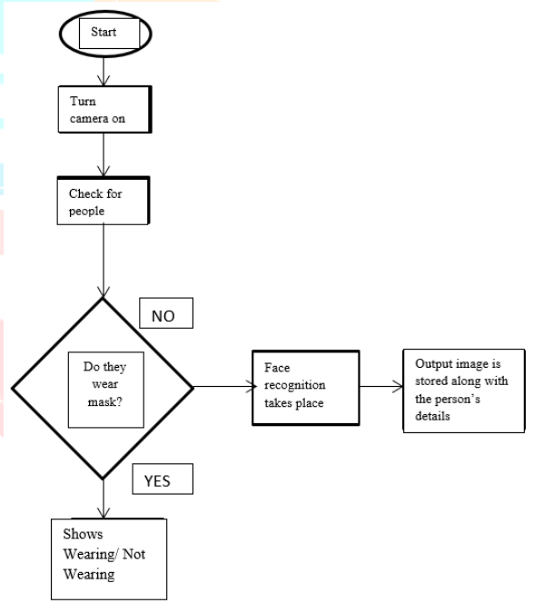
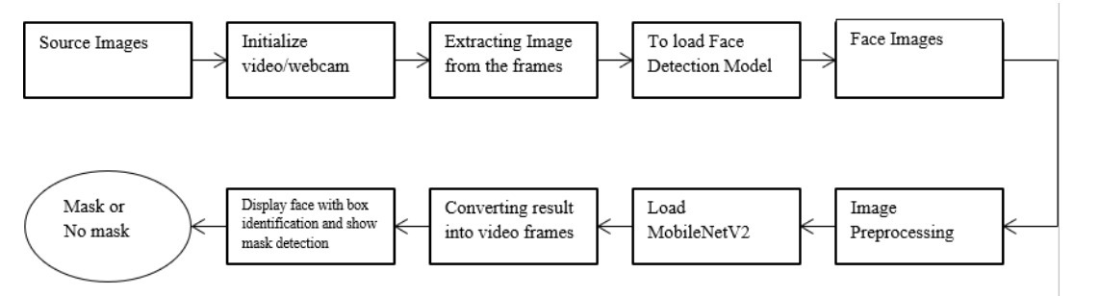
CLASS DIAGRAM

Slide 11
CONSTRAINTS
Although the system performs efficiently in real-time, it faces the following challenges:
The irregularities in images, like those with insufficient light and side angle, need proper attention.
Also, another major challenge is to achieve high accuracy in the least possible time.
Additionally, the video analysis has difficulties, including motion blur, transitioning between frames, etc.

Slide 12
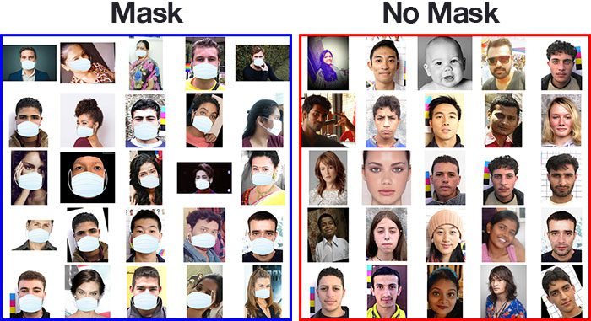
TEST PLAN
Initially datasets are to be collected, this dataset consists of images belonging to two classes:
with_mask
Without_mask
Our goal is to train a custom deep learning model to detect whether a person is or is not wearing a mask.
If the person is not wearing a mask then the system says
Without_mask
If the person is wearing a mask then the system says
with_mask

Slide 13
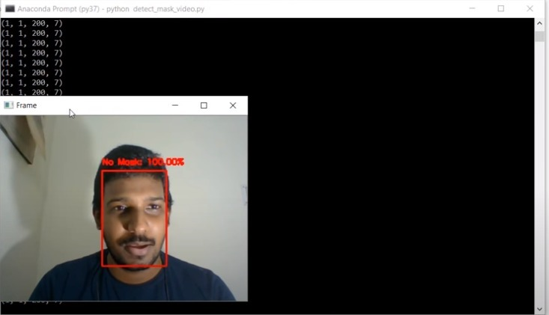
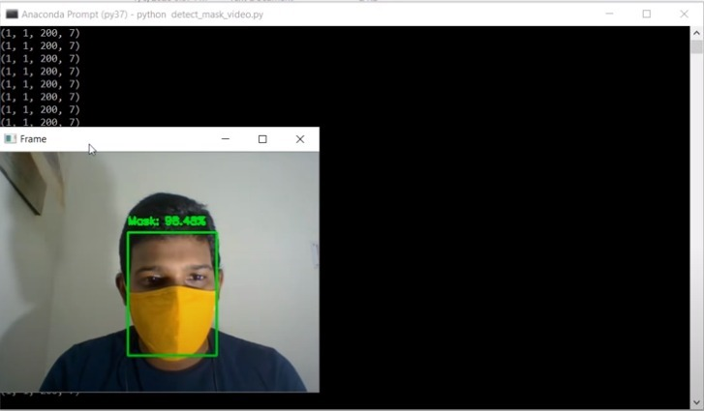
OUTPUT SCREENSHOTS
Without mask
With mask

Slide 14
REFERENCES
Facial Recognition System for People with and without Face Mask in Times of the COVID-19 Pandemic | HTML
https://www.mdpi.com/2071-1050/13/12/6900/htm
Face mask detection using deep learning: An approach to reduce risk of Coronavirus spread - PMC
https://www.ncbi.nlm.nih.gov/pmc/articles/PMC8223067/#b0175
Face mask detection using deep learning: An approach to reduce risk of Corona
https://pyimagesearch.com/2020/05/04/covid-19-face-mask-detector-with-opencv-keras-tensorflow-and-deep-learning/

Slide 15
FUTURE SCOPE
This project can be further extended in the future to include an
exclusive alarm system. The system can implemented to fire an
emergency alarm whenever someone not wearing a mask is
detected, instead of just showing a red square around them.
This
would enable security personnel to easily detect those who are
not wearing a mask, without the need of continuous surveillance
by a human.
The person so caught can be seized and appropriate
disciplinary action can be taken against him/her.

Slide 16
APPLICATIONS
Also it can be modified slightly to make it fit
into certain useful fields
• Medical Hospitals: mask detectors can be used to warn
doctors or med students to not forget masks
• Chemical Plants: mask is a necessity in harmful chemical
releasing factories. With the help of this mask detecting
system, workers safety will be assured.
Drones: Adding this system upon drones would result in
another new useful 360o detection unit that continuously
monitors

Slide 17
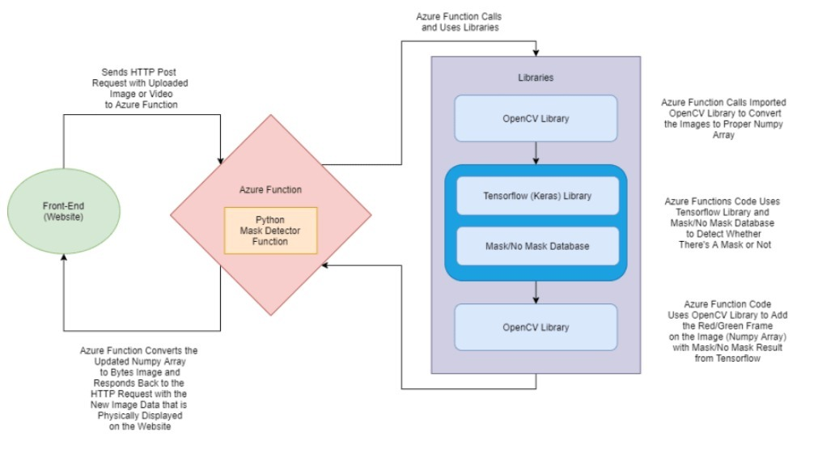
THANKS!

